Slide 1
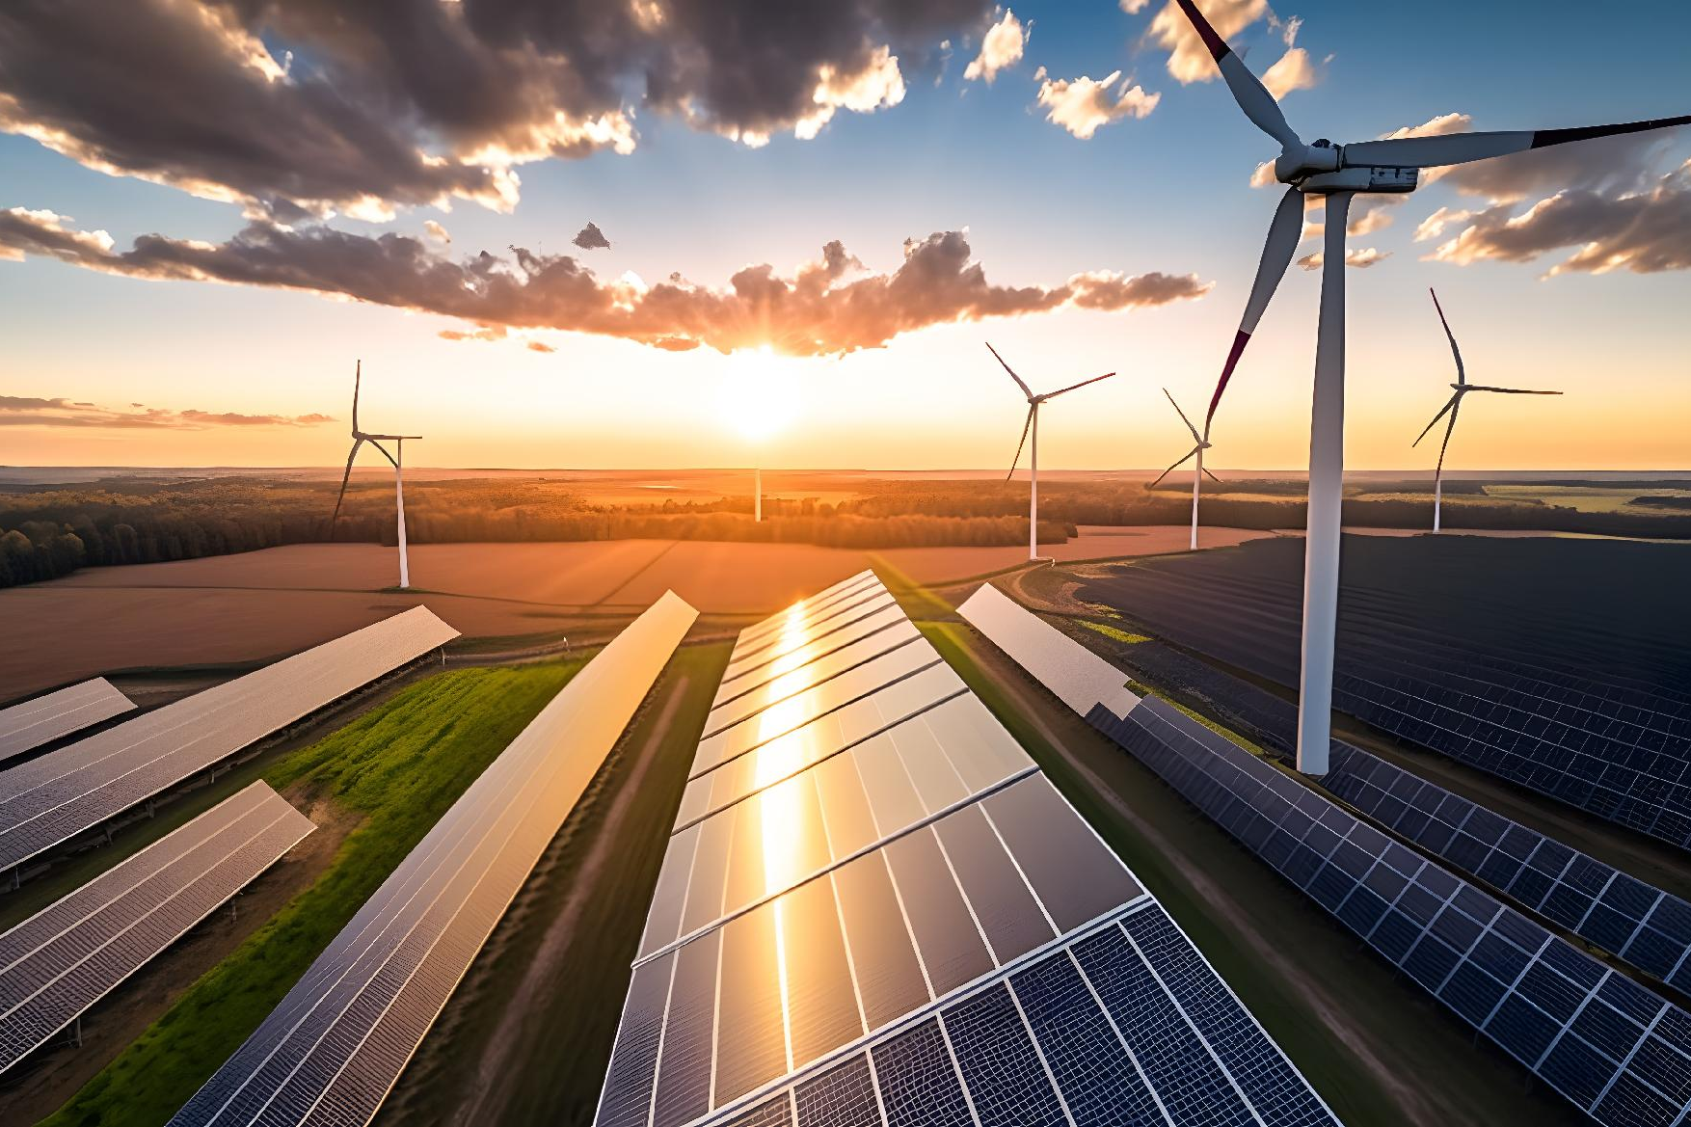
Sustainable Data Center Solution – Client Decision Challenge
Traditional Approach
Lower cost
Faster implementation
Higher carbon footprint
Green Technology Approach
Energy efficient
Environmentally friendly
Higher initial investment
Challenge
Client is concerned about cost and timelines.
Leadership must balance business needs and sustainability goals.
February 4, 2026

Slide 2
Proposed Solution
1. Analyze Cost & Benefits
3. Propose a Hybrid Solution
Compare upfront costs with long-term savings.
Use green technologies where feasible.
Balance budget, timeline, and sustainability.
2. Engage Stakeholders
4. Highlight Long-Term Value
Discuss concerns with client and leadership teams.
Reduced energy costs.
Lower environmental impact.
Improved brand reputation.

